Slide 1

Evaluation - Controlled Experiments
What is experimental design?
What is an experimental hypothesis?
How do I plan an experiment?
Why are statistics used?
What are the important statistical methods?
Slide deck by Saul Greenberg. Permission is granted to use this for non-commercial purposes as long as general credit to Saul Greenberg is clearly maintained.
Warning: some material in this deck is used from other sources without permission. Credit to the original source is given if it is known.

Slide 2
Quantitative evaluation of systems
Quantitative:
  precise measurement, numerical values
  bounds on how correct our statements are
Methods
  user performance data collection
  controlled experiments

Slide 3

Collecting user performance data
Data collected on system use (often lots of data)
Exploratory:
  hope something interesting shows up
  but difficult to analyze
Targeted
  look for specific information, but may miss something
    frequency of request for on-line assistance
      what did people ask for help with?
    frequency of use of different parts of the system
      why are parts of system unused?
    number of errors and where they occurred
      why does an error occur repeatedly?
    time it takes to complete some operation
      what tasks take longer than expected?

Slide 4
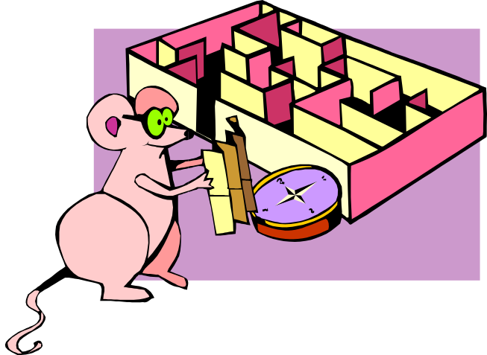
Controlled experiments
Traditional scientific method
Reductionist
  clear convincing result on specific issues
In HCI:
  insights into cognitive process,
  human performance limitations, ...
  allows system comparison,
  fine-tuning of details ...

Slide 5
Controlled experiments
Strives for
  lucid and testable hypothesis
  quantitative measurement
  measure of confidence in results obtained (statistics)
  replicability of experiment
  control of variables and conditions
  removal of experimenter bias

Slide 6
A) Lucid and testable hypothesis
Example
  There is no difference in user performance (time and error rate) when selecting a single item from a pop-up or a pull down menu of 4 items, regardless of the subject’s previous expertise in using a mouse or using the different menu types”
File Edit View Insert
File
New
New
Edit
Open
Open
View
Close
Close
Insert
Save
Save

Slide 7
Independent variables
b) Hypothesis includes the independent variables that are to be altered
  the things you manipulate independent of a subject’s behaviour
  determines a modification to the conditions the subjects undergo
  may arise from subjects being classified into different groups

Slide 8
Independent variables
in menu experiment
    menu type: pop-up or pull-down
    menu length: 3, 6, 9, 12, 15
    subject type (expert or novice)

Slide 9
Dependant variables
c) Hypothesis includes the dependent
variables that will be measured
    variables dependent on the subject’s behaviour / reaction to the independent variable
    the specific things you set out to quantitatively measure / observe

Slide 10
Dependant variables
in menu experiment
    time to select an item
    selection errors made
    time to learn to use it to proficiency
in toothpaste experiment
    number of cavities
    frequency of brushing
    preference

Slide 11


Subject Selection
d) Judiciously select and assign subjects to groups
ways of controlling subject variability
    reasonable amount of subjects
    random assignment
    make different user groups an independent variable
    screen for anomalies in subject group
      superstars versus poor performers
Novice
Expert

Slide 12

Controlling bias
e) Control for bias
    unbiased instructions
    unbiased experimental protocols
      prepare scripts ahead of time
    unbiased subject selection
Now you get to do the
pop-up menus. I think
you will really like them...
I designed them myself!

Slide 13

Statistical analysis
f) Apply statistical methods to data analysis
  confidence limits:
    the confidence that your conclusion is correct
    “the hypothesis that computer experience makes no difference is rejected at the .05 level”
    means:
      a 95% chance that your statement is correct
      a 5% chance you are wrong

Slide 14

Interpretation
g) Interpret your results
  what you believe the results really mean
  their implications to your research
  their implications to practitioners
  how generalizable they are
  limitations and critique

Slide 15
Planning flowchart for experiments
Stage 1
Stage 2
Stage 3
Stage 4
Stage 5
Problem
Planning
Conduct
Analysis
Interpret-
definition
research
ation
feedback
research
define
preliminary
data
interpretation
idea
variables
testing
reductions
literature
generalization
review
controls
data
statistics
collection
reporting
statement of
apparatus
hypothesis
problem
testing
procedures
hypothesis
select
development
subjects
experimental
design
feedback
Copied from an early ACM CHI tutorial, but I cannot recall which one

Slide 16
Statistical analysis
Calculations that tell us
  mathematical attributes about our data sets
    mean, amount of variance, ...
  how data sets relate to each other
    whether we are “sampling” from the same or different distributions
  the probability that our claims are correct
    “statistical significance”

Slide 17
Statistical vs practical significance
When n is large, even a trivial difference may show up as a statistically significant result
  eg menu choice:
  mean selection time of menu a is 3.00 seconds;
  menu b is 3.05 seconds
Statistical significance does not imply that the difference is important!
  a matter of interpretation
  statistical significance often abused and used to misinform

Slide 18
Example: Differences between means
Condition one: 3, 4, 4, 4, 5, 5, 5, 6
Given:
  two data sets measuring a condition
    height difference of males and females
    time to select an item from different menu styles ...
Question:
  is the difference between the means of this data statistically significant?
Null hypothesis:
  there is no difference between the two means
  statistical analysis:
    can only reject the hypothesis at a certain level of confidence
Condition two: 4, 4, 5, 5, 6, 6, 7, 7

Slide 19
Example:
mean = 4.5
3
2
Is there a significant difference
between these means?
1
Condition one: 3, 4, 4, 4, 5, 5, 5, 6
0
3 4 5 6 7
Condition 1
Condition 1
3
mean = 5.5
2
1
Condition two: 4, 4, 5, 5, 6, 6, 7, 7
0
3 4 5 6 7
Condition 2
Condition 2

Slide 20

Problem with visual inspection of data
Will almost always see variation in collected data
  Differences between data sets may be due to:
    normal variation
      eg two sets of ten tosses with different but fair dice
        differences between data and means are accountable by expected variation
    real differences between data
      eg two sets of ten tosses for with loaded dice and fair dice
        differences between data and means are not
        accountable by expected variation

Slide 21
T-test
A simple statistical test
  allows one to say something about differences between means at a certain confidence level
Null hypothesis of the T-test:
  no difference exists between the means
  of two sets of collected data
possible results:
  I am 95% sure that null hypothesis is rejected
    (there is probably a true difference between the means)
  I cannot reject the null hypothesis
    the means are likely the same

Slide 22
Different types of T-tests
Comparing two sets of independent observations
  usually different subjects in each group
  number per group may differ as well
    Condition 1 Condition 2
    S1–S20 S21–43
Paired observations
  usually a single group studied under both experimental conditions
  data points of one subject are treated as a pair
    Condition 1 Condition 2
    S1–S20 S1–S20

Slide 23
Different types of T-tests
Non-directional vs directional alternatives
  non-directional (two-tailed)
    no expectation that the direction of difference matters
  directional (one-tailed)
    Only interested if the mean of a given condition is greater than the other

Slide 24
T-test...
Assumptions of t-tests
  data points of each sample are normally distributed
    but t-test very robust in practice
  population variances are equal
    t-test reasonably robust for differing variances
    deserves consideration
  individual observations of data points in sample are independent
    must be adhered to
Significance level
  decide upon the level before you do the test!
  typically stated at the .05 or .01 level

Slide 25
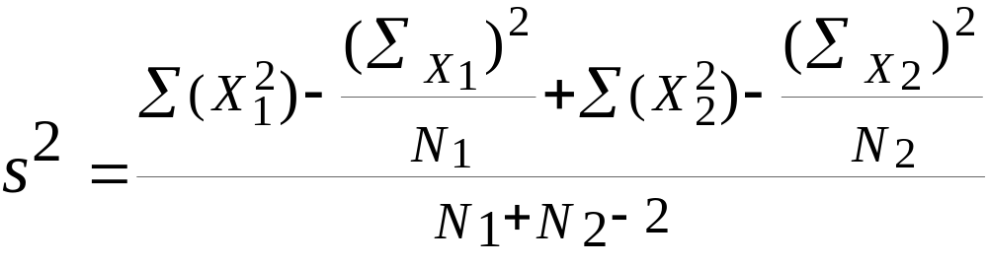
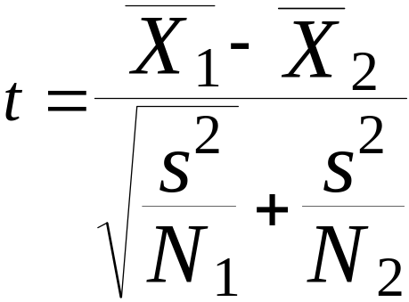
Two-tailed unpaired T-test
N: number of data points in the one sample
ΣX: sum of all data points in one sample
X: mean of data points in sample
Σ(X²): sum of squares of data points in sample
s²: unbiased estimate of population variation
t: t ratio
df = degrees of freedom = N1 + N2 – 2
Formulas

Slide 26
Level of significance for two-tailed test
df .05 .01
1 12.706 63.657
2 4.303 9.925
3 3.182 5.841
4 2.776 4.604
5 2.571 4.032
6 2.447 3.707
7 2.365 3.499
8 2.306 3.355
9 2.262 3.250
10 2.228 3.169
11 2.201 3.106
12 2.179 3.055
13 2.160 3.012
14 2.145 2.977
15 2.131 2.947
df .05 .01
16 2.120 2.921
18 2.101 2.878
20 2.086 2.845
22 2.074 2.819
24 2.064 2.797

Slide 27
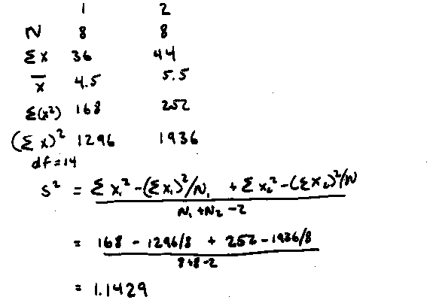
Example Calculation
x₁ = 3 4 4 4 5 5 5 6 Hypothesis: there is no significant difference
x₂ = 4 4 5 5 6 6 7 7 between the means at the .05 level
Step 1. Calculating s²

Slide 28
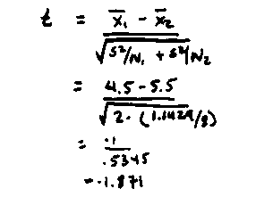
Example Calculation
Step 2. Calculating t

Slide 29
Example Calculation
df .05 .01
1 12.706 63.657
…
14 2.145 2.977
15 2.131 2.947
Step 3: Looking up critical value of t
  Use table for two-tailed t-test, at p=.05, df=14
  critical value = 2.145
  because t=1.871 < 2.145, there is no significant difference
  therefore, we cannot reject the null hypothesis
  i.e., there is no difference between the means

Slide 30
Two-tailed Unpaired T-test
Or, use a statistics package (e.g., Excel has simple stats)
Condition one: 3, 4, 4, 4, 5, 5, 5, 6
Condition two: 4, 4, 5, 5, 6, 6, 7, 7
Unpaired t-test
DF:
Unpaired t Value:
Prob. (2-tail):
14
-1.871
.0824
Group:
Count:
Mean:
Std. Dev.:
Std. Error:
one
8
4.5
.926
.327
two
8
5.5
1.195
.423

Slide 31
Significance levels and errors
Type 1 error
  reject the null hypothesis when it is, in fact, true
Type 2 error
  accept the null hypothesis when it is, in fact, false
Effects of levels of significance
  high confidence level (eg p<.0001)
    greater chance of Type 2 errors
  low confidence level (eg p>.1)
    greater chance of Type 1 errors
You can ‘bias’ your choice depending on consequence of these errors

Slide 32
Type I and Type II Errors
Type 1 error
  reject the null hypothesis when it is, in fact, true
Type 2 error
  accept the null hypothesis when it is, in fact, false
Decision
 | False | True
True | Type I error | 
False |  | Type II error
“Reality”

Slide 33

Example: The SpamAssassin Spam Rater
A SPAM rater gives each email a SPAM likelihood
  0: definitely valid email…
  1:
  2:
  …
  9:
  10: definitely SPAM
SPAM likelihood
 1

Spam Rater
 3


5
 7
9
7

Slide 34



Example: The SpamAssassin Spam Rater
A SPAM assassin deletes mail above a certain SPAM threshold
  what should this threshold be?
  ‘Null hypothesis’: the arriving mail is SPAM
<=X
 1

Spam Rater
 3


5
 7
>X
9
7

Slide 35
Example: The SpamAssassin Spam Rater
Low threshold = many Type I errors
  many legitimate emails classified as spam
  but you receive very few actual spams
High threshold = many Type II errors
  many spams classified as email
  but you receive almost all your valid emails
<=X
 1

Spam Rater
 3


5
 7
>X
9
7

Slide 36
Which is Worse?
Type I errors are considered worse because the null hypothesis is meant to reflect the incumbent theory.
BUT
you must use your judgement to assess actual risk of being wrong in the context of your study.

Slide 37
Significance levels and errors
There is no difference between Pie and traditional pop-up menus
What is the consequence of each error type?
  Type 1:
    extra work developing software
    people must learn a new idiom for no benefit
  Type 2:
    use a less efficient (but already familiar) menu
Which error type is preferable?
  Redesigning a traditional GUI interface
    Type 2 error is preferable to a Type 1 error
  Designing a digital mapping application where experts perform extremely frequent menu selections
    Type 1 error preferable to a Type 2 error
Close
Open
New
Save
New
Open
Close
Save

Slide 38
Scales of Measurements
Four major scales of measurements
  Nominal
  Ordinal
  Interval
  Ratio

Slide 39

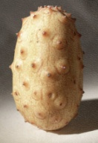

Nominal Scale
Classification into named or numbered unordered categories
  country of birth, user groups, gender…
Allowable manipulations
  whether an item belongs in a category
  counting items in a category
Statistics
  number of cases in each category
  most frequent category
  no means, medians…
With permission of Ron Wardell

Slide 40
Nominal Scale
Sources of error
  agreement in labeling, vague labels, vague differences in objects
Testing for error
  agreement between different judges for same object
With permission of Ron Wardell

Slide 41


Ordinal Scale
Classification into named or numbered ordered categories
  no information on magnitude of differences between categories
  e.g. preference, social status, gold/silver/bronze medals
Allowable manipulations
  as with interval scale, plus
  merge adjacent classes
  transitive: if A > B > C, then A > C
Statistics
  median (central value)
  percentiles, e.g., 30% were less than B
Sources of error
  as in nominal
With permission of Ron Wardell

Slide 42


Interval Scale
Classification into ordered categories with equal differences between categories
  zero only by convention
  e.g. temperature (C or F), time of day
Allowable manipulations
  add, subtract
  cannot multiply as this needs an absolute zero
Statistics
  mean, standard deviation, range, variance
Sources of error
  instrument calibration, reproducibility and readability
  human error, skill…
With permission of Ron Wardell

Slide 43
Ratio Scale
Interval scale with absolute, non-arbitrary zero
  e.g. temperature (K), length, weight, time periods
Allowable manipulations
  multiply, divide
With permission of Ron Wardell

Slide 44
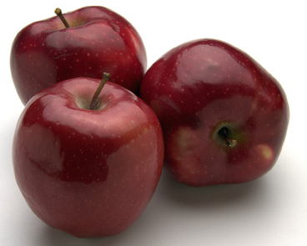
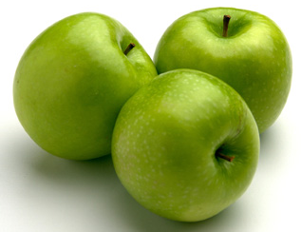
Example: Apples
Nominal:
  apple variety
    Macintosh, Delicious, Gala…
Ordinal:
  apple quality
    US. Extra Fancy
    U.S. Fancy,
    U.S. Combination Extra Fancy / Fancy
    U.S. No. 1
    U.S. Early
    U.S. Utility
    U.S. Hail
With permission of Ron Wardell

Slide 45
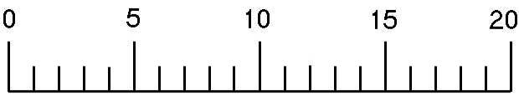
Example: Apples
Interval:
  apple ‘Liking scale’
  Marin, A. Consumers’ evaluation of apple quality. Washington Tree Postharvest Conference 2002.
    After taking at least 2 bites how much do you like the apple?
    Dislike extremely Neither like or dislike Like extremely
Ratio:
  apple weight, size, …
With permission of Ron Wardell

Slide 46
Correlation
Measures the extent to which two concepts are related
  eg years of university training vs
  computer ownership per capita
How?
  obtain the two sets of measurements
  calculate correlation coefficient
    +1: positively correlated
    0: no correlation (no relation)
    –1: negatively correlated

Slide 47
Correlation
10
r² = .668
condition 1 condition 2
9
5
6
4
5
8
6
7
4
4
5
6
7
3
5
5
7
4
4
6
5
7
6
7
6
6
5
7
7
6
8
4
7
9
3
2.5
3
3.5
4
4.5
5
5.5
6
6.5
7
7.5
Condition 1
Condition 1

Slide 48
Correlation
Dangers
  attributing causality
    a correlation does not imply cause and effect
    cause may be due to a third “hidden” variable related to both other variables
  drawing strong conclusion from small numbers
    unreliable with small groups
    be wary of accepting anything more than the direction of correlation unless you have at least 40 subjects

Slide 49
Correlation
10
Pickles eaten
per month
Salary per year
(*10,000)
r² = .668
9
5
6
4
5
8
6
7
4
4
5
6
7
3
5
5
7
Salary per year (*10,000)
4
4
6
5
7
6
7
6
6
5
7
7
6
8
4
7
9
3
Which conclusion could be correct?
-Eating pickles causes your salary to increase
-Making more money causes you to eat more pickles
-Pickle consumption predicts higher salaries because
older people tend to like pickles better than younger
people, and older people tend to make more money than
younger people
2.5
3
3.5
4
4.5
5
5.5
6
6.5
7
7.5
Pickles eaten per month

Slide 50
Other Tests: Regression
Calculates a line of “best fit”
Use the value of one variable to predict the value of the other
    e.g., 60% of people with 3 years of university own a computer
10
y = .988x + 1.132, r2 = .668
y = .988x + 1.132, r2 = .668
9
condition 1 condition 2
5
6
8
4
5
6
7
4
4
7
5
6
Condition 2
3
5
6
5
7
4
4
5
7
5
6
7
6
6
7
7
4
6
8
7
9
3
3
4
5
6
7
Condition 1

Slide 51
Single Factor Analysis of Variance
Compares three or more means
e.g. comparing mouse-typing on three keyboards:
  Possible results:
    mouse-typing speed is
      fastest on a qwerty keyboard
      the same on an alphabetic & dvorak keyboards
Qwerty
Alphabetic
Dvorak
S1-S10
S11-S20
S21-S30

Slide 52
Analysis of Variance (Anova)
Compares relationships between many factors
  Provides more informed results
  considers the interactions between factors
  example
    beginners type at the same speed on all keyboards,
    touch-typist type fastest on the qwerty
Qwerty
Alphabetic
Dvorak
cannot
S1-S10
S11-S20
S21-S30
touch type
can
S31-S40
S41-S50
S51-S60
touch type

Slide 53
You know now
Controlled experiments can provide clear convincing result on specific issues
Creating testable hypotheses are critical to good experimental design
Experimental design requires a great deal of planning

Slide 54
You know now
Statistics inform us about
  mathematical attributes about our data sets
  how data sets relate to each other
  the probability that our claims are correct
There are many statistical methods that can be applied to different experimental designs
  T-tests
  Correlation and regression
  Single factor Anova
  Anova

Slide 55
The mean of the x values
The mean of the y values
The standard deviation of the x values (denoted s_{x})
The standard deviation of the y values (denoted s_{y})
The correlation between X and Y (denoted r)
Finding the slope of a regression line
The formula for the slope, m, of the best-fitting line is
where r is the correlation between X and Y, and s_{x} and s_{y} are the standard deviations of the x-values and the y-values, respectively. You simply divide s_{y}by s_{x} and multiply the result by r.

Slide 56
B=mean(y)-m mean(x)

